Slide 1
COMMCARE
CommCare is a software program that allows people to create and manage mobile applications through the website, CommCareHQ.
Its is the overall tool for building applications, making changes, downloading applications to phones, registering the application users, and viewing data submissions.
It is a Cross-platform, open source mobile and web cloud product used by Frontline Workers (FLWs) across a variety of sectors, including community health workers, agricultural extension workers, mobile trainers, and supervisors.
It replaces cumbersome paper registers, reporting forms, and client education flipcharts with an open source cloud product that can run on simple Java enabled phones, as well as higher end android smart phones and tablets.
CommCare automatically submits visit data in ‘real-time’ to a central cloud server, CommCareHQ. Data on this server is privacy-protected, backed up, and accessible to supervisors and program managers around the world.

Slide 2
Usages of Commcare
It can be used for a number of purposes, including:
Data collection - a tool for mobile users to directly digitize information so that it can be accessed via a computer
Decision support - supports complex logic that can guide a user to asking the right questions and providing appropriate advice
Job aid - as a case management tool CommCare can help users to prioritize tasks, remind users to make visits, and do complex calculations
Counseling tool - with embedded multimedia like images, audio, and video, CommCare can enhance the counseling experience

Slide 3
Components of Commcare
There are two components of CommCare:
CommCareMobile is the mobile device part of CommCare, usually a mobile "application." This could be a phone, tablet, or someone entering data using a computer
CommCareHQ is the website (www.commcarehq.org) where users can access data, design applications, and manage mobile workers

Slide 4
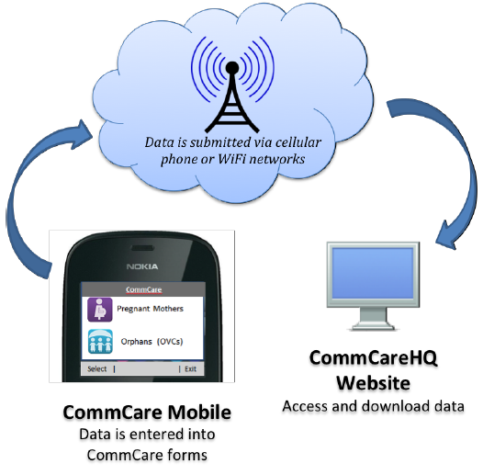
Data in CommCare
In CommCare, the general flow of data is from a mobile user to CommCareHQ. From CommCareHQ it is visible to any CommCareHQ/web user with permission to view it.

Slide 5
Data in CommCare (Continued)
In general there are two levels of data in CommCare:
Raw Data – this is data from the questions contained in a form.
For example:
Question like “what is the patient’s birthday,” that data is then visible in CommCareHQ as raw or key indicator data.
2. Worker Activity – this is data about how and when mobile workers are submitting forms.
For Example:
Information like “yesterday mobile user Samantha submitted 10 forms”

Slide 6
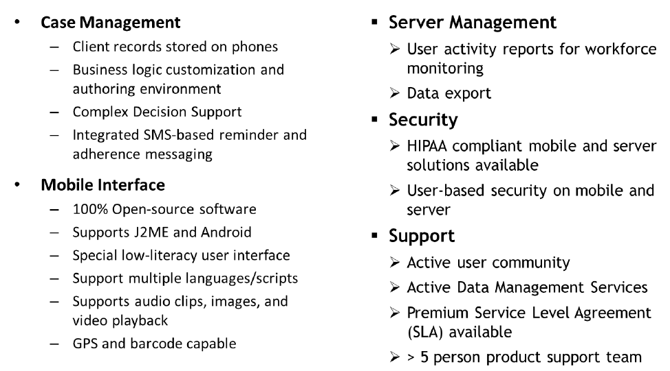
Features

Slide 7
Challenges Addressed by Commcare
CommCare improves care across four areas:
Access to care through client lists on the CHWs' phones and SMS reminders when visits are due;
Client engagement through audio and video clips and improved credibility of the CHW;
Quality of care through checklists, decision support, and delivery of sensitive information through recorded voices; and
Accountability of care through real-time monitoring of the CHWs’ activities.

Slide 8
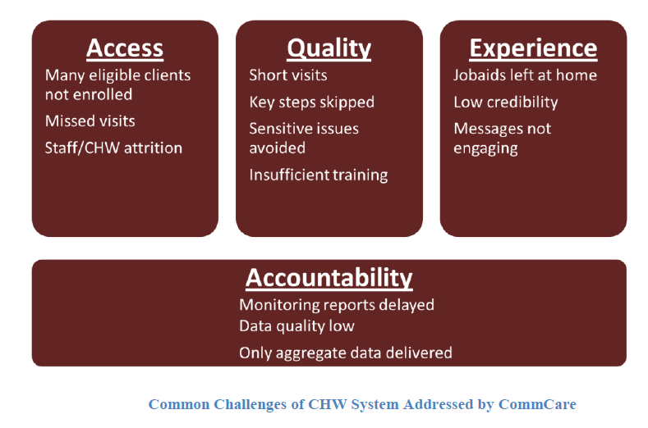
Challenges Addressed by Commcare (Continued)

Slide 9
Functionalities it can provide
Client tracking
The ability to store client information offline
Multimedia prompts for low-literate users and client engagement
Ability to run on Java-enabled phones for current deployments and on Android phones for future deployments, and authoring tools that allow non-programmers to create CommCare applications.
Ability to store data on phone if it could not be delivered because of no signal or any other problem. So it can function in places where there is not always consistent access to network.

Slide 10
Functionalities it can provide (Continued)
Allow us to know details like
Which mobile user submitted it
How long did it take to complete the form?
When was the form sent to the CommCareHQ server over the cellular or WiFi network?
What are the answers to the questions in the form (raw data)?
To whom or what was the form related?
It helps in keeping the worker activities record like:
how frequently does a given mobile worker submit a form related to a given case
how many forms does a given mobile worker submit over a time period
which forms are being submitted by a given mobile worker over a time Period
Functionalities provided to CommCareHQ/Web Users
Create, modify, and download/deploy CommCare applications
Create, manage, and delete mobile user accounts
View and export data submitted by mobile workers
Send text messages to mobile workers
Manage workspace settings

Slide 11
Functionalities it can provide (Continued)
These functionalities can be used with the MOTECH platform to manage patient information more effectively and implement voice- and text-based messaging directly to end users.

Slide 12
Resources Used:
Commcare overview august-2012
CommCare Fundamentals Guide 5MAR2014
CommCare Evidence Base October 2014
Video: https://www.youtube.com/watch?v=ZpfvISKxylE

